Slide 1
Week 3 : Introduction to Programming
Python
Monday, June 19th

Slide 2
REVIEW
Where we are…..
Web Development (Front-End)
Web Development (Back End)
Introduction to Programming(Python)
Programming for Machine Learning(Python)

Slide 3
Logistics
Workshop 1 happens everyday Monday to Friday 8.30am to 10.30am.
Bathroom and Tea break at 10.30am-11.00 am
Workshop 2 happens everyday Monday to Friday 11.00am to 12.30pm
Slides are posted on GitHub at https://github.com/msoma2017/

Slide 4
Questions?

Slide 5
Ice Breaker
Please tell us your name preceded by an adjective that describes you (should have the same first letter as your name). Please include what you would like to learn.
For example: I am magnificent Monicah and I’m hoping to learn XYZ….

Slide 6
Pre-BootCamp
Required Installations:
Python 3
GitHub
Text Editor

Slide 7
Python
Python is a popular programming language that emphasizes readability by enforcing indentation
Source: https://www.tiobe.com/tiobe-index/
Jun 2017 | Jun 2016 | Change | Programming Language | Ratings | Change
1 | 1 |  | Java | 14.493% | -6.30%
2 | 2 |  | C | 6.848% | -5.53%
3 | 3 |  | C++ | 5.723% | -0.48%
4 | 4 |  | Python | 4.333% | +0.43%
5 | 5 |  | C# | 3.530% | -0.26%

Slide 8
Write your first Python program!!
Hello World!

Slide 9
Python
Some common functions/things to know
print() is used to display the values of whatever is enclosed within it’s brackets
input() gets user input
Comments in Python begin with a hash sign # for single line commenting
Multiline comments are enclosed within triple double/single quotes
\n new line (similar to ‘enter’)
\t tab (equal to spaces)

Slide 10
Variables
Variables are containers for storing information.
The equal sign = is the assignment operator.
a = `Hello, world!'
print (a)
a = `Hello, world!'
a = `and goodbye...'
print (a)
Multiple assignment is possible e.g. a,b = 1,1 is the same as simultaneously doing a=1 and b=1
Initialization is the process of assigning an initial value to a variable
The method type() is used to return the type of a variable.
Variables can’t start with a number or with a Python keyword. To view a list of keywords type:
>>> import keyword
>>> keyword.kwlist
['False', 'None', 'True', 'and', 'as', 'assert', 'break', 'class', 'continue', 'def', 'del', 'elif', 'else', 'except', 'finally', 'for', 'from', 'global', 'if', 'import', 'in', 'is', 'lambda', 'nonlocal', 'not', 'or', 'pass', 'raise', 'return', 'try', 'while', 'with', 'yield']

Slide 11
Basic Types
int
integer e.g. 3,2,4
float
floating point numbers – 2.002, 3.2848
str
Strings. Enclosed by single or double quotes e.g. “…..” , ‘….’
Concatenation of strings can be done using the + sign or by placing them next to each other.
Strings are index-able from 0 on the left and -1 from the right
Slicing e.g. word[2:5] – from index 2(included) to index 5(excluded), word[:2]
Strings are immutable i.e. trying to change the value of an indexed position gives an error e.g. word[2] = ‘d’
len() returns the length of a string
\ is the escape character e.g. print(‘Isn\’t that wonderful’)

Slide 12
Python as a calculator
Most symbols work just as in other languages:
+, -, * ,
/ division- always returns a floating point number
() grouping
//floor division
** raising to power
% remainder of the division
_ the last printed expression
r’ raw string
Notes:
If you don’t want characters prefaced by \ to be interpreted as special characters, you can use raw strings by adding an r before the first quote:
print('C:\some\name')
print(r'C:\some\name')

Slide 13
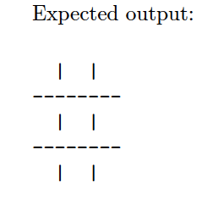
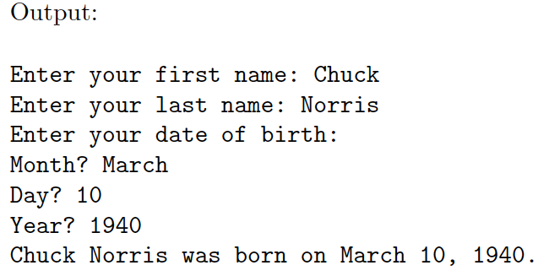
In class Exercise:
Design a program that prints out a tic tac toe game like below. Try doing first without variables and then with variables.
Write a program that will ask the user for their first and last name, and date of birth, and print them out formatted.

Slide 14
Other Types
bool
Boolean. Don’t need to be enclosed in quotes e.g. sunny, rainy = True, False
lists
A list is defined as a comma separated list of values enclosed by square brackets e.g. siblings = [3,5,6,3]
Concatenation of lists can be done using the + sign
Just like Strings, lists can be indexed and sliced. siblings[0] = 3; siblings[1:3] = [5,6] Slicing returns lists
Unlike strings, lists are mutable i.e. you can change the value of an indexed position e.g. siblings [2] = 8
len() returns the length of a string
append() is used to add an item to the end of the list

Slide 15
Types
tuples
A tuple is as a comma separated list of values enclosed by () e.g. siblings = (3,5,6,3)
Concatenation can be done using the + sign
Just like strings and lists can be indexed and sliced. siblings[0] = 3; siblings[1:3] = [5,6] Slicing returns tuples
Immutable i.e. you cannot change the value of an indexed
len() returns the length of a string
>>> t = () # initializing an empty tuple
>>> t1 = 1, # a tuple of len 1
>>> t = 3, 5, 6 # tuple packing

Slide 16
Types
dict
A dictionary is a comma separated list of key-value pairs enclosed by curly brackets {}. Keys can be strings, ints, floats, tuples but not lists
A dictionary can be initialized by using dict() or using {}
d = dict()
d2 = {}
A dictionary can be populated:
With dict()
Giving dict() a list of key-value tuple pairs
Example_dictionary = dict([('sape', 4139), ('guido', 4127), ('jack', 4098)])
Giving dict()’raw’ key-value pairs
Example_dictionary = dict(sape=4139, guido=4127, jack=4098)
Without dict()
Example_dictionary = { 'sape': 4139 , 'guido': 4127 ,'jack': 4098}

Slide 17
Types
dict
Dictionary keys are unordered but they must be unique
You can look-up the value of a key by:
>>> Example_dictionary['sape']
4139
dict.keys() returns all the keys e.g. Example_dictionary.keys()
dict.values() returns all the keys e.g. Example_dictionary.values()
Simple Exercise
Create a dictionary with the following city postal codes: rusinga→ 40327, taveta → 80302, oyugis → 40222 .
Add an extra city ‘siaya’ with postal code 40600
Look up the name of the city with postal code 80302
Print out all the postal codes
Print out all the city names

Slide 18
Try:
Create a Python program the prints out the Fibonacci sequence. In the Fibonacci sequence, every number except the first two numbers, is the sum of the two preceding ones.
1 ,1 ,2 ,3 ,5 ,8 ,13 …..
Hints:
Start by creating an empty list with 1,1 e.g. fibonacci_list = [1,1]
Notes:
fibonacci_list = [1,1]
fibonacci_list.append(fibonacci_list[-1]+fibonacci_list[-2])

